Slide 1
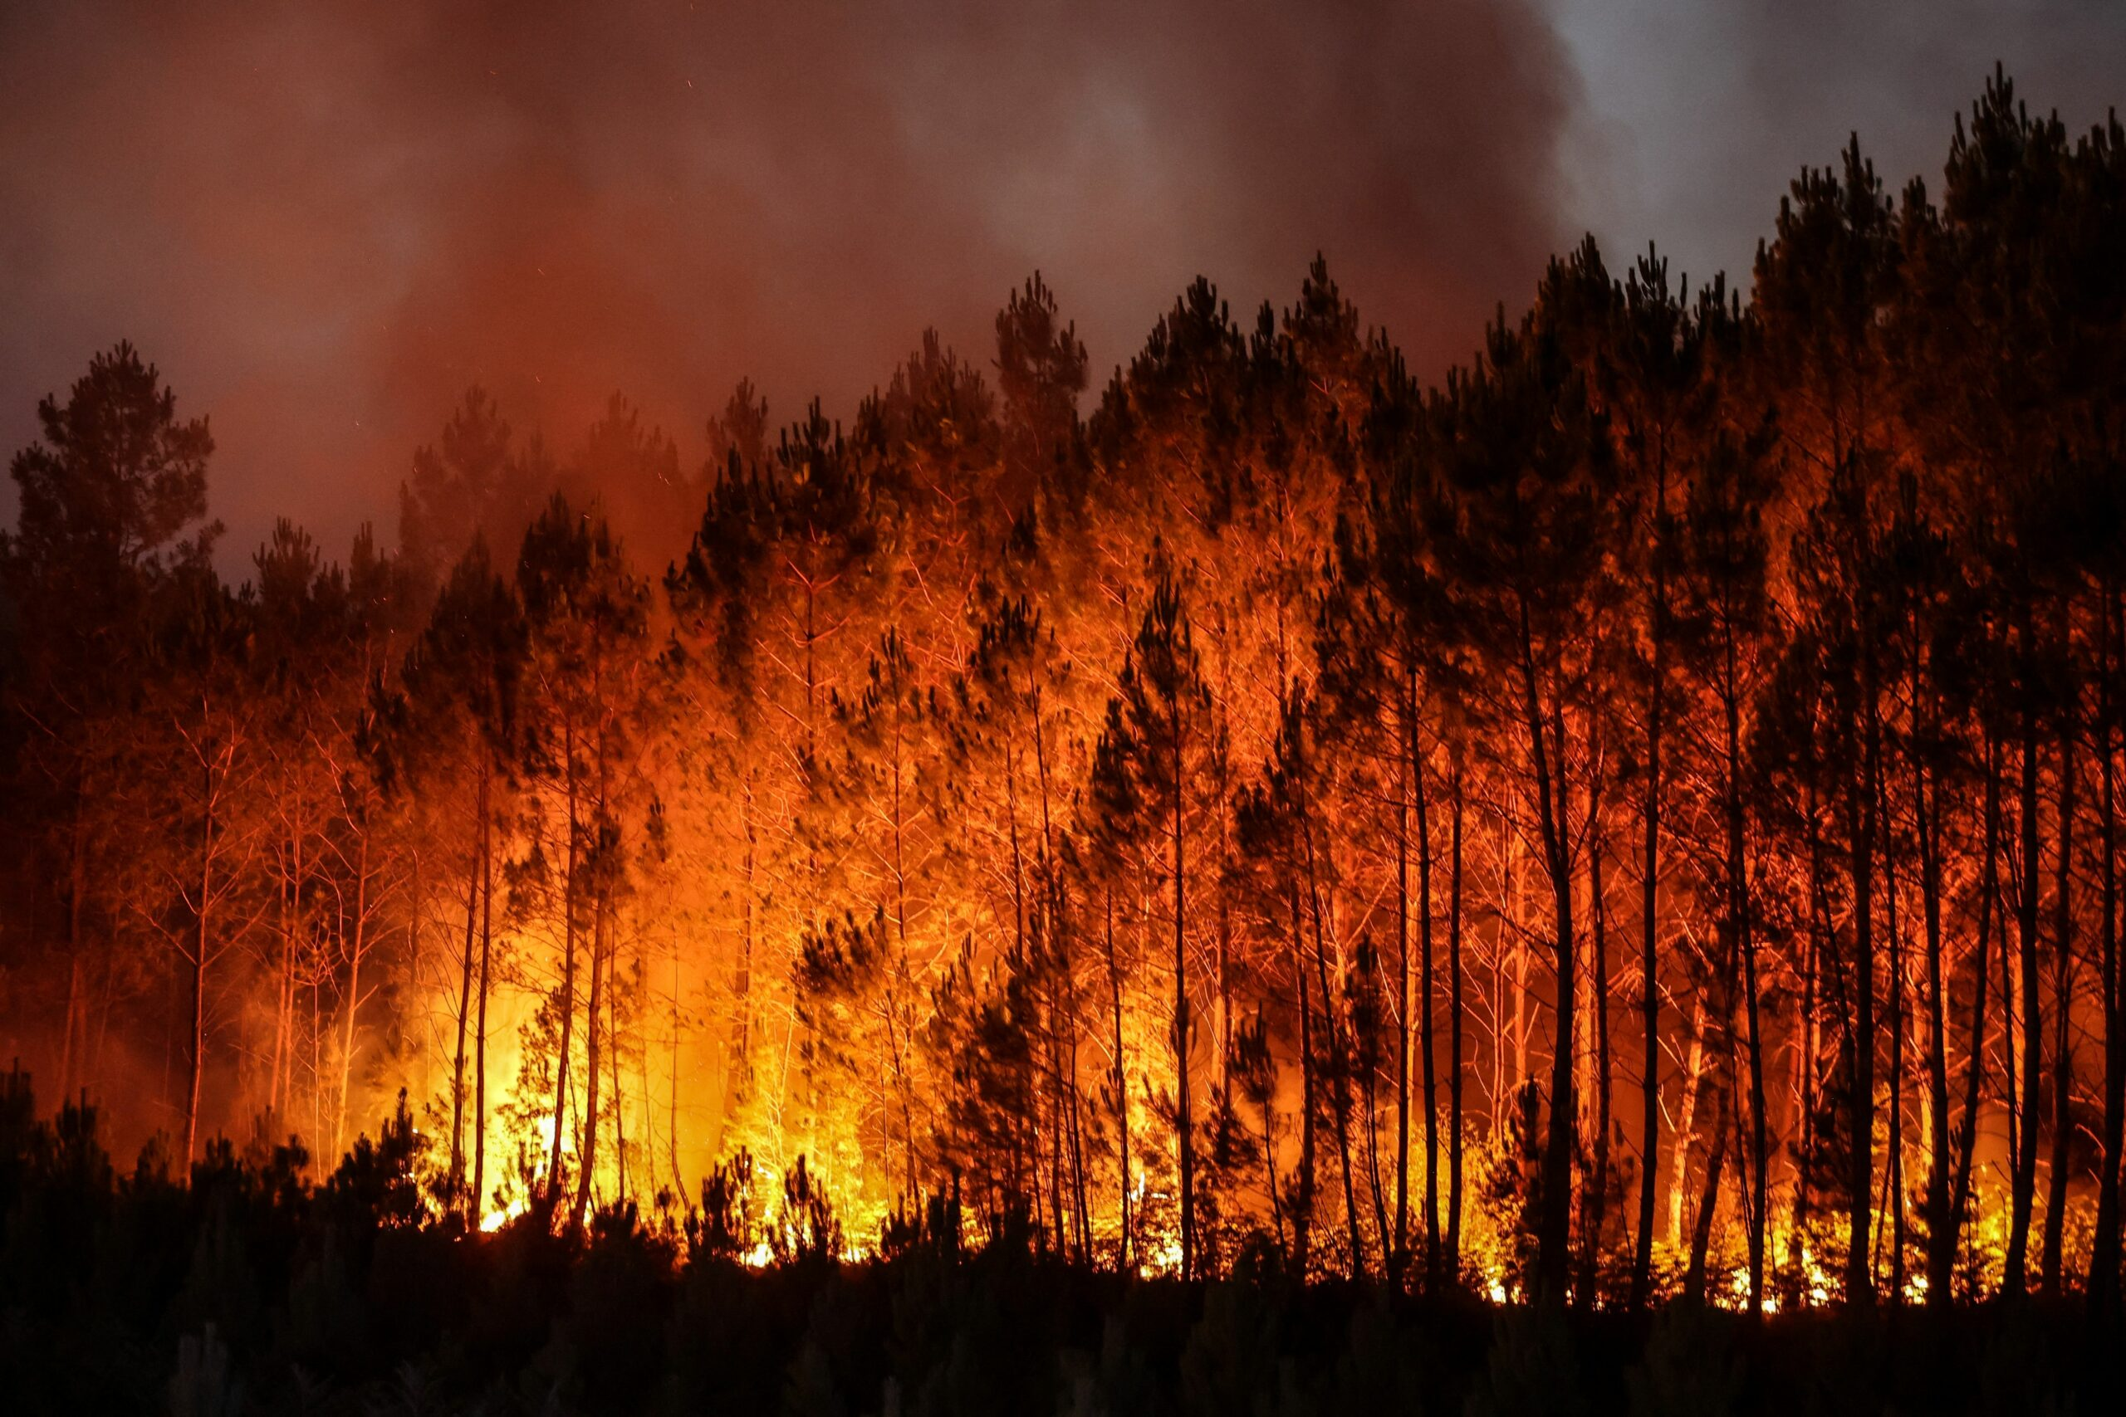
Wildfires
David Spir
Alexis Rojas
Artem Zalivchiy
Eduardo Mestre

Slide 2
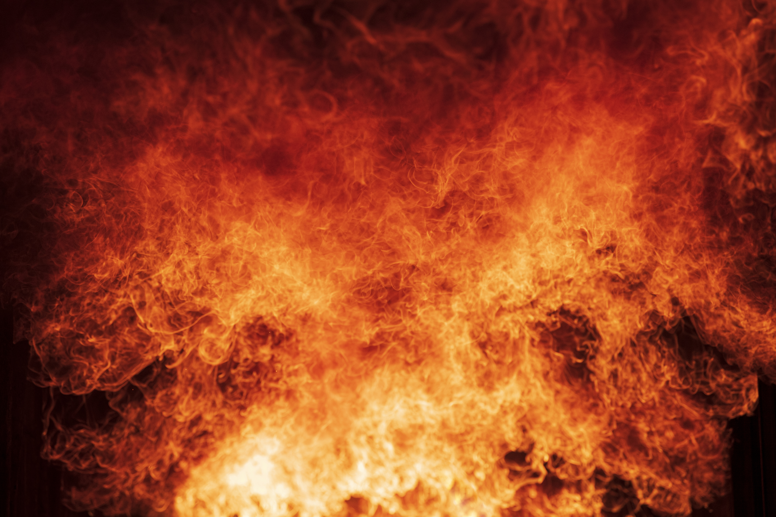
Introduction
A wildfire is an uncontrolled fire that burns in wildland vegetations, including rural areas, shrublands/grasslands, savannas, croplands, forests, and more.
We will be using several datasets that will help us identify how much area is burnt every week per country, the total land area burnt per year, as well as the type of land (ecosystem) burnt per year.
The data we will be using were taken from the years 2012-2022

Slide 3
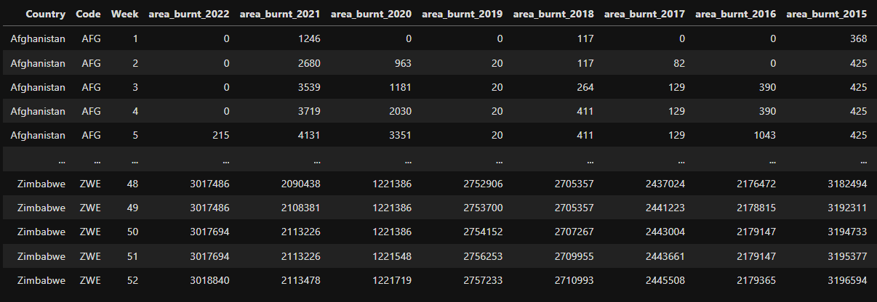
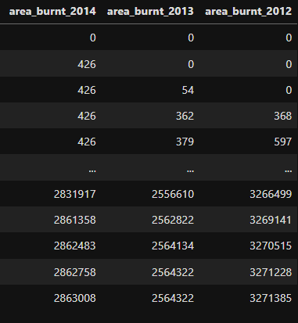
Cumulative Area Burnt by Wildfires per Week
To help track the evolution of wildfires across the year, it is important to take note of their weekly progression.

Slide 4
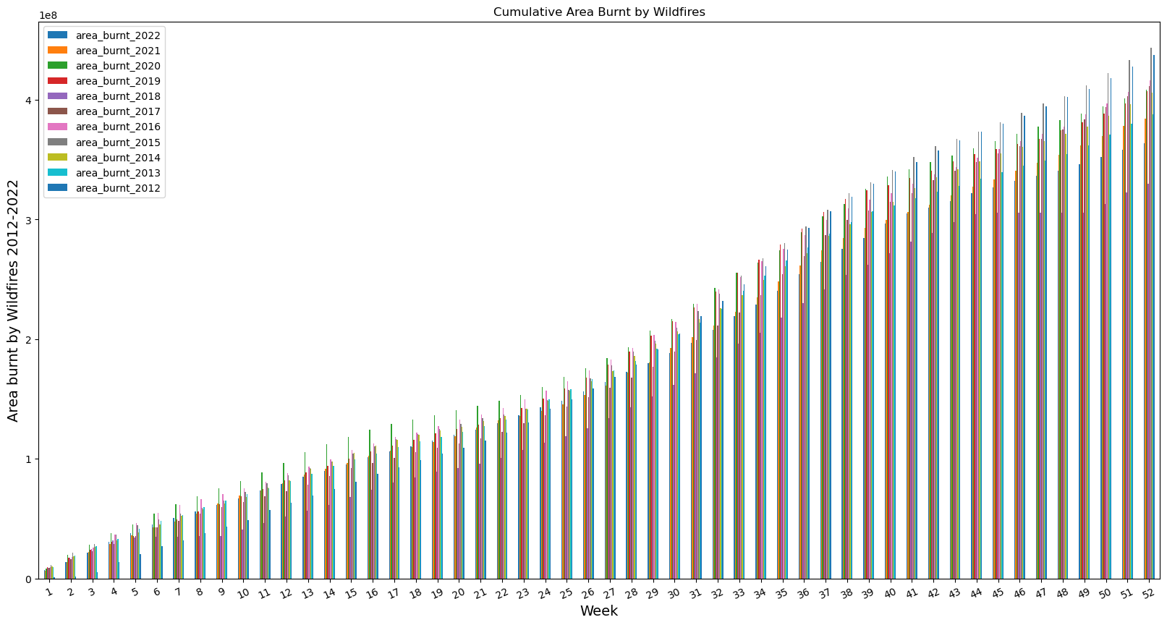
The graph visually represents the weekly progression of wildfires around the world.
The data allows us to see whether wildfires have started earlier/later than expected, and it used to compare to other years to help make predictions.

Slide 5
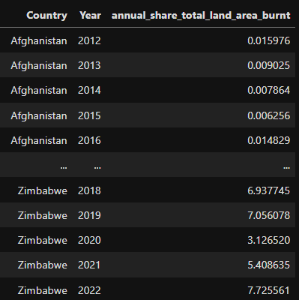
Share of the Total Land Area Burnt Yearly
Total area consumed by wildfires between 2012-2022. Fires may occur in the same land area multiple times over the years.

Slide 6
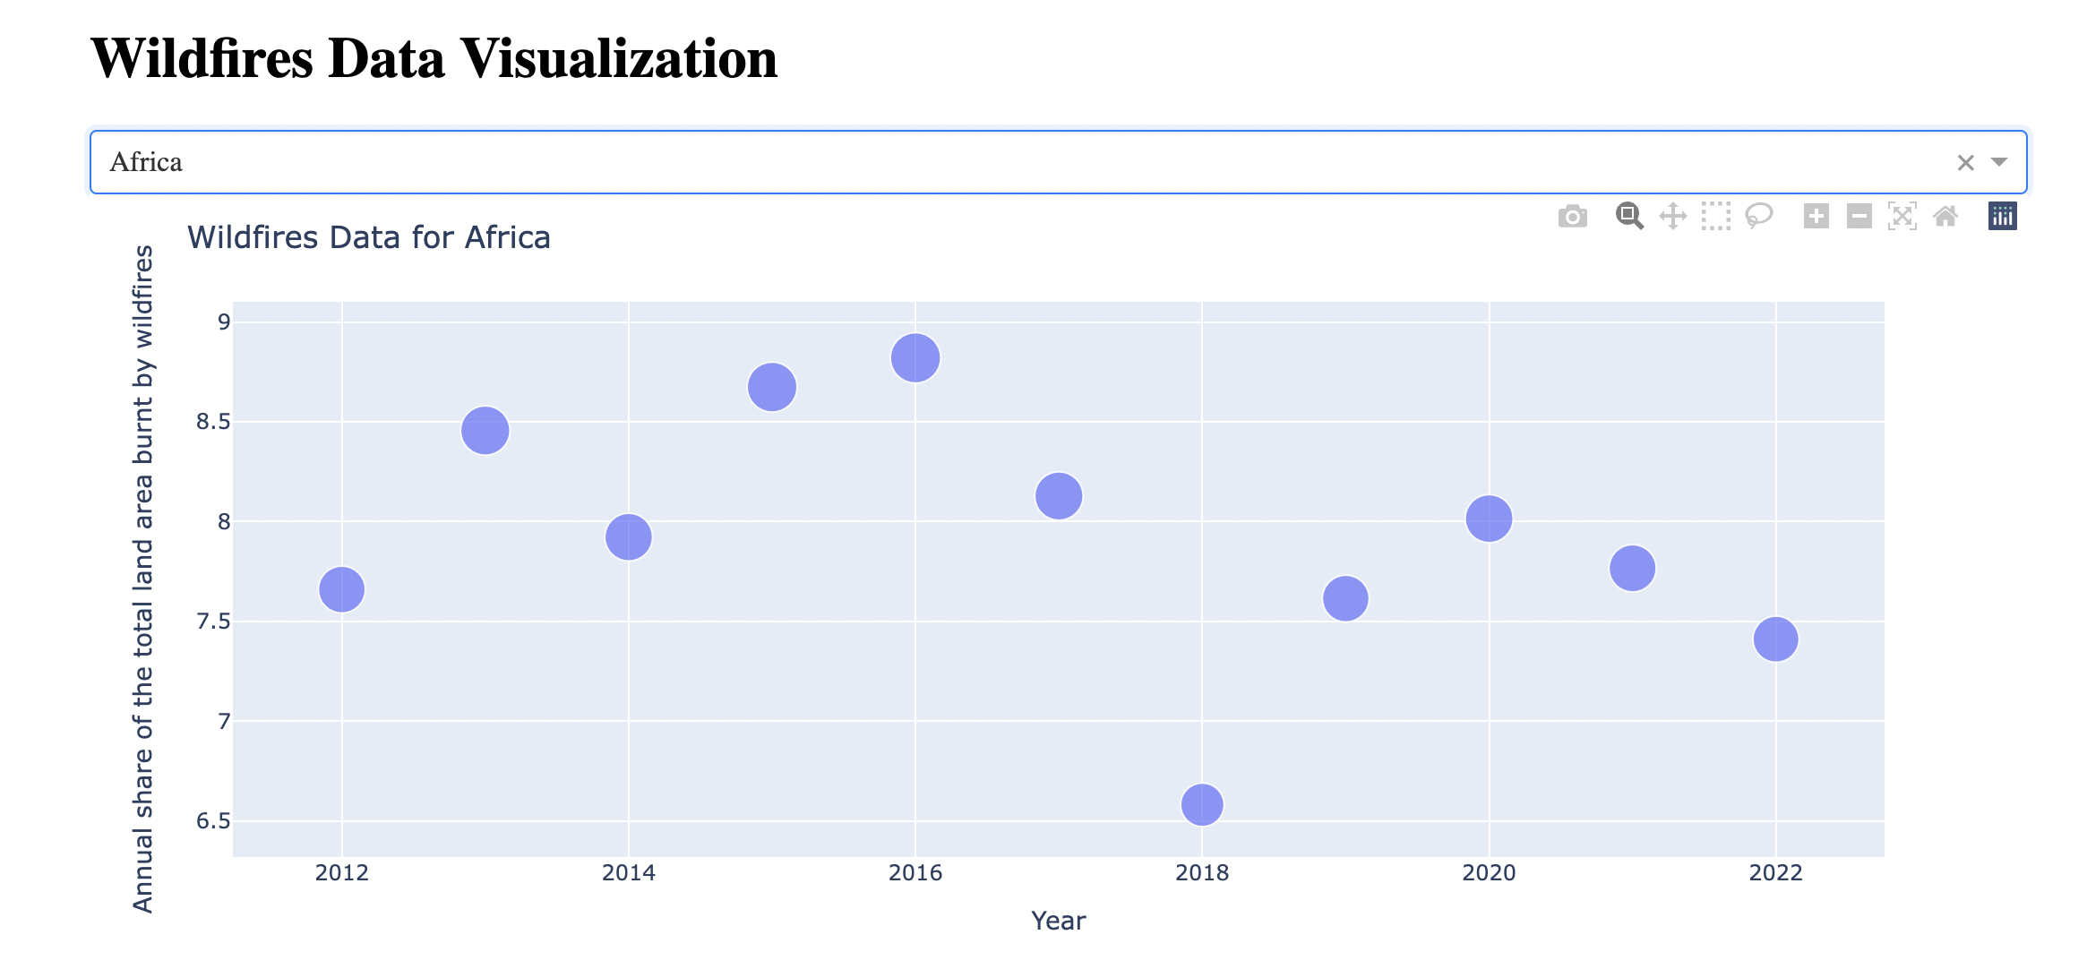
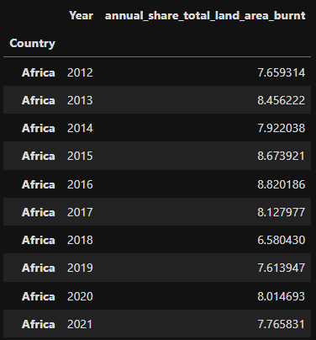
Africa is usually the region with the largest share of land area burned. The highest shown was in 2016 with an 8.8% share of land area burnt.

Slide 7
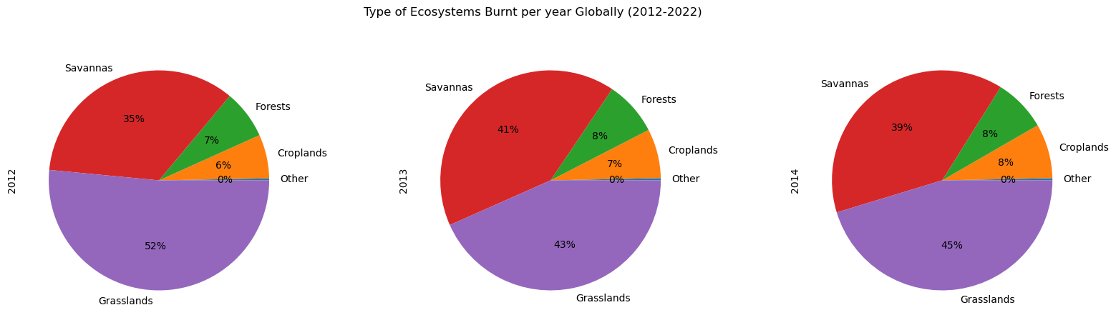
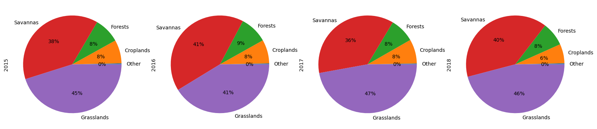
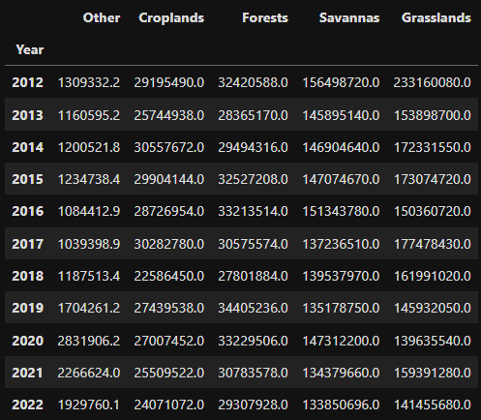
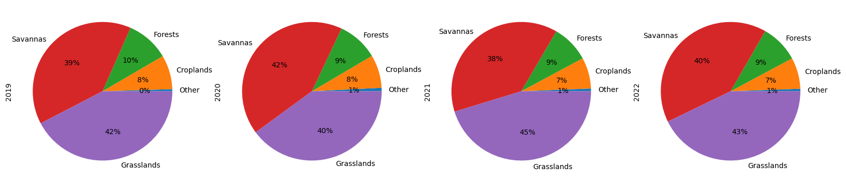
Ecosystems Burnt Yearly
Wildfires can burn various types of ecosystems. Large areas of savannas and grasslands tend to burn more each year compared to other types of land.

Slide 8
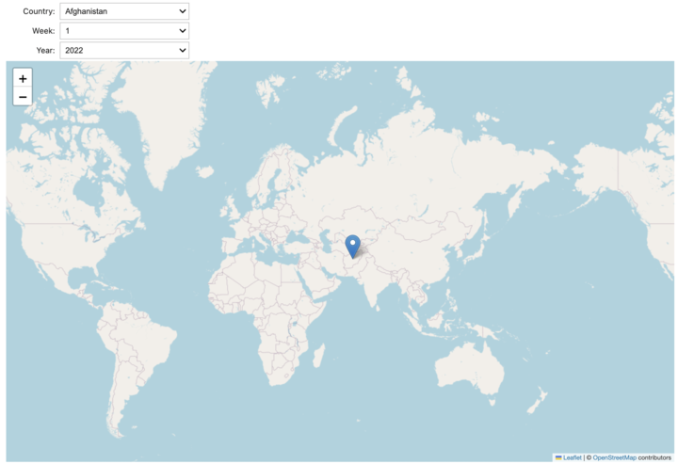
Folium

Slide 9
Ethical Considerations
Utilizing this information in a safe way both for individuals and the environment
Although this project’s goal is for educational purposes, some information obtained from this project can used to harm people or property
We can use this data to implement provisions when it comes to fire safety.
References:
https://www.kaggle.com/datasets/imtkaggleteam/wildfires?select=5-+annual-burned-area-by-landcover.csv

